Slide 1


AUTOMATION

Slide 2



FRAMEWORK
EYES ON COMPETITION
“What are the big boys up to?”
DISRUPTIVE TECHNOLOGIES
“What could sweep the rug from under our feet?”
REPUTATION
“What is the buzz about us in the web-sphere?”
What information is relevant?
Where is it to be found?
How is it applied?

Slide 3
FRAMEWORK
3
What information is relevant?
GEO-SPATIAL: GEO-TAGGED, REMOTE SENSING
MEDIA REPORTS, PREPARED REPORTS, STATUTORY FILINGS
POD-CASTS, VIDEOS
Where is it to be found?
FILE SYSTEMS, DATABASES
SOCIAL SPHERE: TWITTER, FACEBOOK
WEB-SPHERE: WWW
How is it applied?
DECISIONS
2
1
Notes:
Develop RGY Scorecard | X: 3 Questions | Y: Business Unit (Biotech, Technology, IT, Supply Chain, Sales & Marketing) | Z: Eyes on Competition, Disruptive Technologies, Reputation | Set criteria for RGY scorecard
Prioritize 2 use-cases for demonstration. 1 Global, 1 Regional.
Acquire data

Slide 4




TECHNOLOGIES

Slide 5

API MAGIC

Slide 6


UNIT TESTING

Slide 7
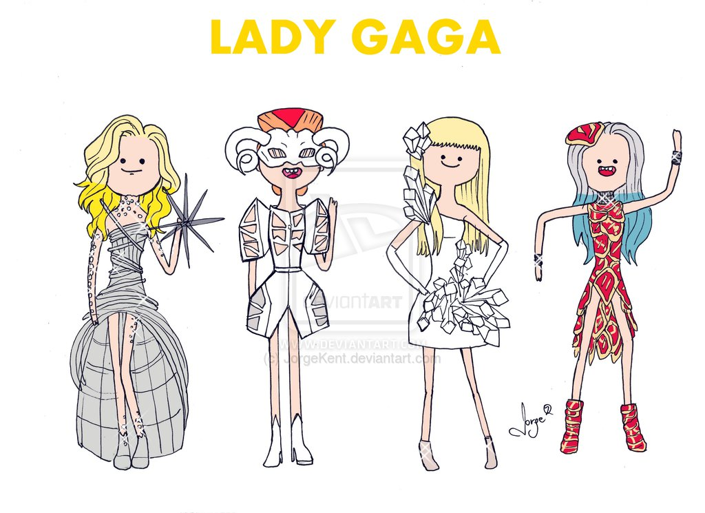

VERSION CTRL

Slide 8

MOBILITY STACK

